Slide 1
Link Analysis PageRank, Community Detection
Chien Chin Chen

Slide 2
Preface
Text information nowadays are usually with links that convey useful information.
Hyperlinks of wiki pages
Hash tags that refer to a certain event of concept
Link structure is thus worthwhile investigating!!
Here, we talk about link analysis. We especially focus on two subjects:
Node Ranking: analyze the link structure to identify important nodes in a network.
Widely used by search engines to identify important pages.
Community Detection: identify sub-networks, each consists of nodes close to each other.
Is a clustering problem!!
Has marketing function that discovers groups of intimate users in a social network.

Slide 3


PageRank (1/12)
A major component used by Google to weight web pages when answering user queries.
It has intellectual antecedents in the field of citation analysis.
The discipline seeks to quantify the influence of scholarly articles by analyzing the pattern of citations among them.
Citations usually represent the conferral of authority from a scholarly article to others.

Slide 4
PageRank (2/12)
Hyperlinks from a web page to another can be treated as a conferral of authority.
So … can we simply measure the quality of a web page by the number of in-links?
No … not every citation or hyperlinks implies such authority conferral.
Most corporate websites have a pointer from every page to a page containing a copyright notice.
Link spam – setting up multiple pages pointing to a target web page to artificially boosting the latter’s authority.

Slide 5
PageRank (3/12)
PageRank assigns every node (web page) in the web graph a numerical score (PageRank score) between 0 and 1.
The score depends on the link structure of the web graph.
When computing in-degree, we have treated each edge as a vote to determine the prestige of each node.
However … in a network, not all of the votes are considered equally important.
The prestige of a node does not only depend on how many pages pointing to it but also depend on the quality of those pages.

Slide 6
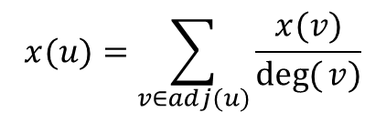
PageRank (4/12)
This consideration can be expressed by the equation:
Every page has a prestige value.
And distribute this value to its neighbors.
To better understand PageRank, we talk about stochastic web surfing.
$$x(u)=\sum_{v∈adj(u)}{\frac{x(v)}{\deg{(}v)}}$$
the prestige
of page u
the out-degree
of page v
the set of pages
that point to u

Slide 7
PageRank (5/12)
Let P be the transition probability matrix of web pages.
E.g.,
the probability that the next visit is j,
conditioned on the current visit being i
The entries in each row add up to 1
P
0 | 0.5 | 0.5
1 | 0 | 0
1 | 0 | 0
3
1
2
Also known as stochastic matrix

Slide 8
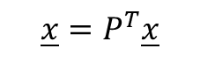
PageRank (6/12)
We can write the last equation in the matrix notation as:
$$\underline{x}=P^{T}\underline{x}$$
prestige vector
P^{T}
x(1)
x(2)
x(3)
0 | 1 | 1
0.5 | 0 | 0
0.5 | 0 | 0
x(1)
x(2)
x(3)
=
3
1
2

Slide 9
PageRank (7/12)
The stochastic web surfing process begins at a web page.
At each time step, the suffer proceeds from his current page p to a randomly chosen web page that p hyperlinks to.
As the surfer proceeds in this random walk from node to node, he visits some nodes more often than others.
Intuitively, these are nodes with many in-links coming from other frequently visited nodes.
Therefore, pages visited more often in this walk are more important.

Slide 10
PageRank (8/12)
We can depict the probability distribution (over the pages) of the surfing by a probability vector x.
At t = 0, the surfing may begin at a state whose corresponding entry in x₀ is 1 while all others are zero.
At t = 1, the surfing distribution is x₁=P^{T}x₀.
P^{T}
0
0.5
0.5
0 | 1 | 1
0.5 | 0 | 0
0.5 | 0 | 0
1
0
0
3
1
2
=
x₀

Slide 11
PageRank (9/12)
At t = 2, the surfing distribution is x₂=P^{T}x₁.
Or x₂=(P^{T})²x₀.
Consequently, x_{n}=(P^{T})^{n}x₀.
To identify important pages (frequently visited pages), we can continue this stochastic process.
A page whose corresponding entry in x_{n} are high can be regarded as an important page.
But … we need to consider two questions …
Will different x₀ result in different probability vector x_{n}.
Which n is the best.
Or will x_{n} converge to a steady-state distribution π.
Not going to the detail of the mathematics; but showing an import component of PageRank – teleport that ensures the existing of π regardless the setting of x₀.

Slide 12
PageRank (10/12)
To reach π of the web surfing, Page et al. (1998) suggest reserving some low probability for jumping to any node in the graph.
Teleport – a surfer might jump to any node in the web graph by typing an address into the URL bar of his/her browser.
The new transition probability matrix P then can be defined as follows:
Let matrix A be an NxN adjacency matrix of the web graph.
A_{ij}=1 if there is a hyperlink from page i to page j.
Divide each 1 in A by the number of 1’s in its row.
Multiply the resulting matrix by 1 – α.
Add α/N to every entry of the resulting matrix to obtain P.

Slide 13
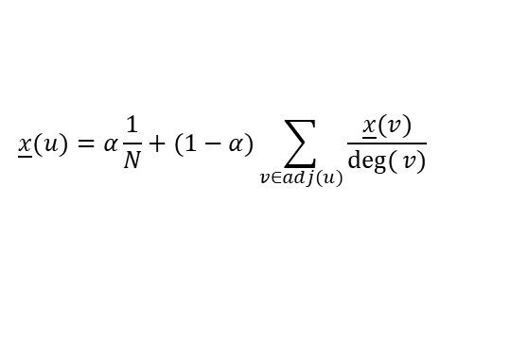
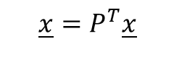
PageRank (11/12)
Example:
0 | 1 | 0
1 | 0 | 1
0 | 1 | 0
1
2
3
$$\underline{x}=P^{T}\underline{x}$$
Let α=0.5
A
1/3 | 1/3 | 1/3
1/3 | 1/3 | 1/3
1/3 | 1/3 | 1/3
0 | 1 | 0
1/2 | 0 | 1/2
0 | 1 | 0
$$\underline{x}(u)=α\frac{1}{N}+(1−α)\sum_{v∈adj(u)}{\frac{\underline{x}(v)}{\deg{(}v)}}$$
0.5
+
(1-0.5)
The equation shown in the PageRank paper; and α is suggested in the interval [0.1, 0.2].
P
1/6 | 2/3 | 1/6
5/12 | 1/6 | 5/12
1/6 | 2/3 | 1/6

Slide 14
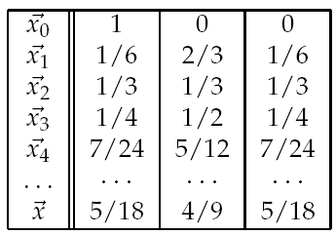
PageRank (12/12)
Example:
Let x₀ = (1 0 0)^{T}.
Image that the surfing starts in page 1.
Note that π will be independent of the initial distribution x₀.
1
2
3
1/6 | 2/3 | 1/6
5/12 | 1/6 | 5/12
1/6 | 2/3 | 1/6
P

Slide 15

Practice Time (1/5)
Data: scikit-network – Les Miserables
You need to install scikit-network in your environment
pip install scikit-network
Built-in dataset
77 nodes (characters)
508 weighted links
Weight: # of scene co-occurrences

Slide 16
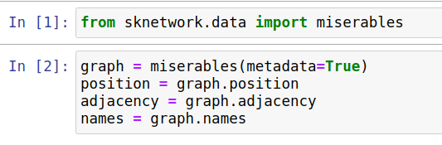
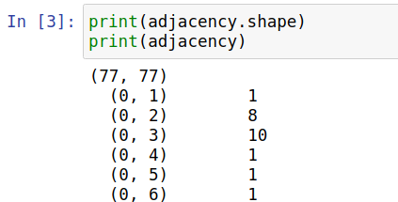
Practice Time (2/5)
77 characters by 77 characters matrix

Slide 17
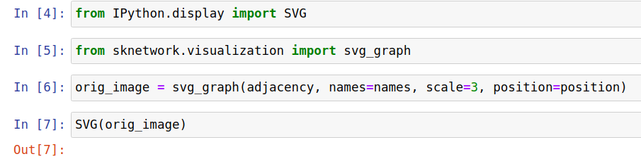
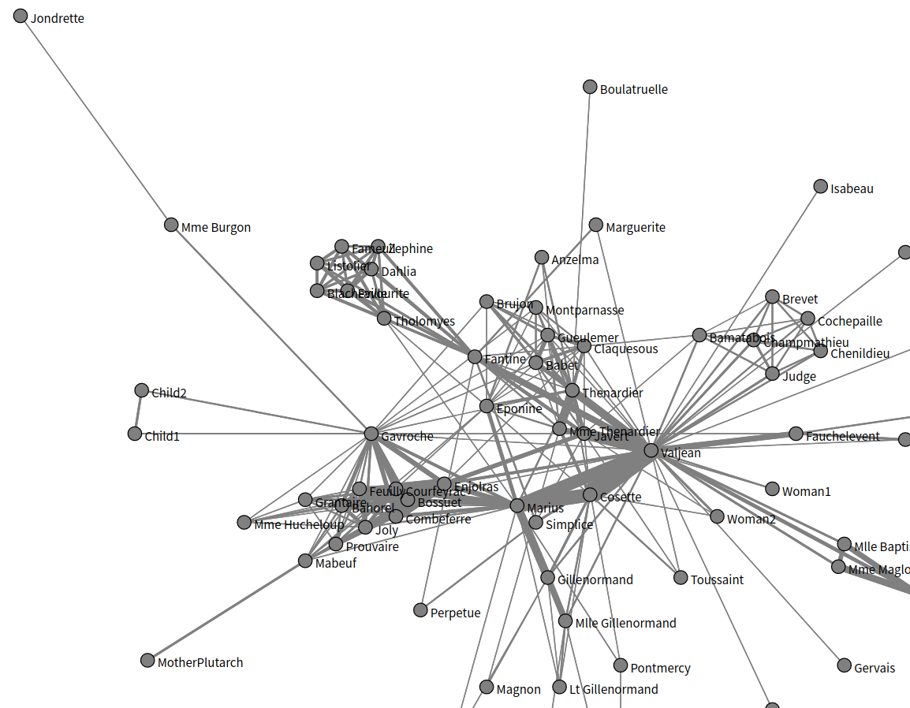
Practice Time (3/5)

Slide 18
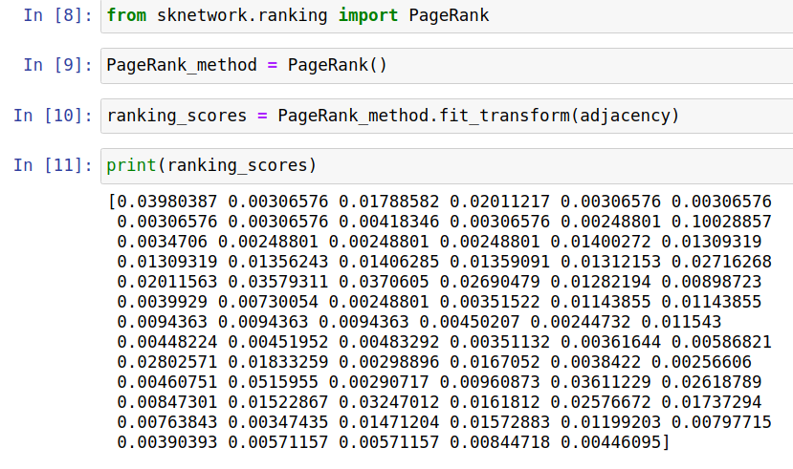
Practice Time (4/5)

Slide 19
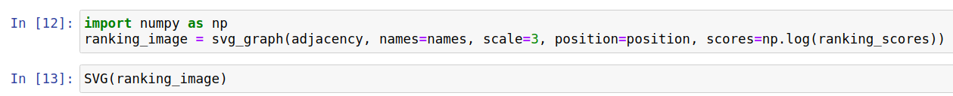

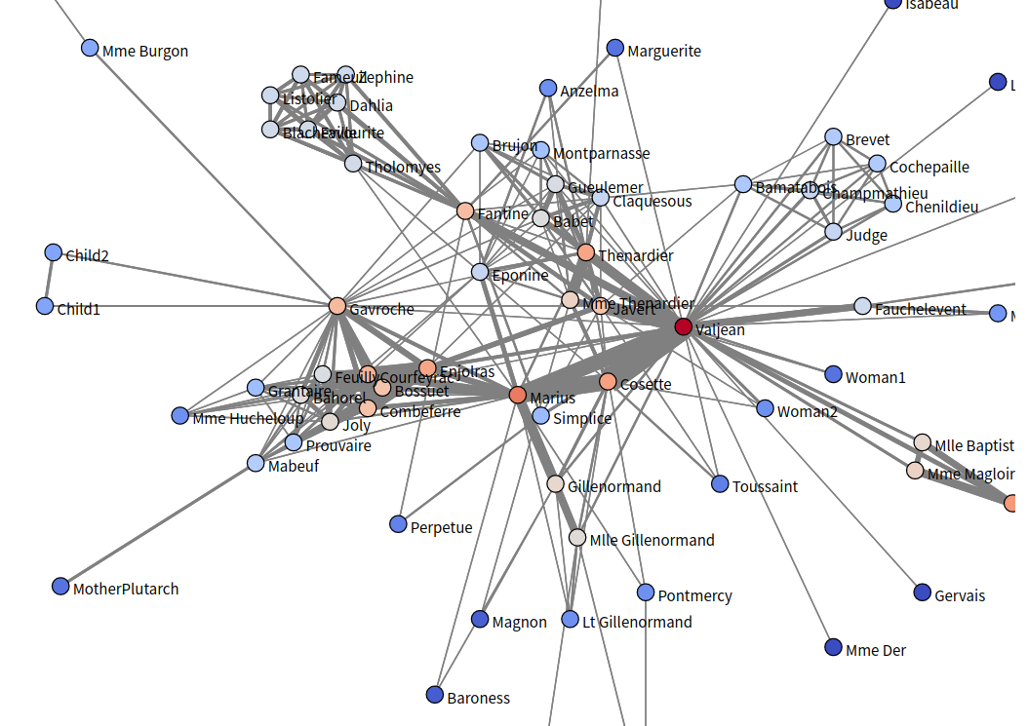
Practice Time (5/5)

Slide 20
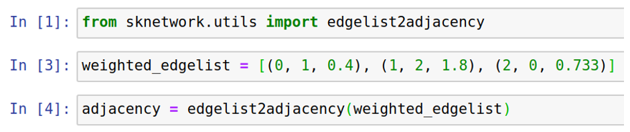
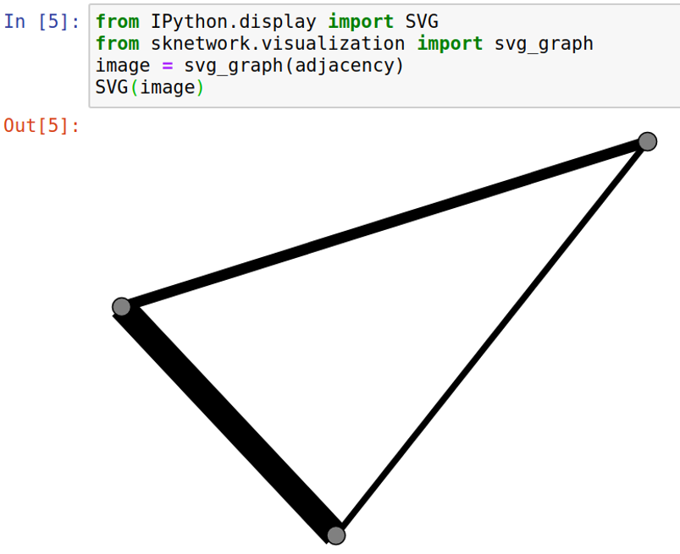
How to Create My Own Network?
Networks are depicted by adjacency matrices
sknetwork.utils.edgelist2adjacency()helps you construct your adjacent matrix

Slide 21
Community Detection (1/4)
How many friends do you have on Facebook?
Different groups of friends in your social media.
High school classmates, family, co-workers …
Each group has its own purpose.
The connections within each groups are dense.
Implicit networks also form communities.
#my2K @ Twitter

Slide 22
Community Detection (2/4)
Given a network, the task of community detection is to identify sub-networks.
The association (e.g., # of links) between the nodes in the sub-network is maximized; while the association between the sub-networks is minimized.
It is a clustering problem!!
Many clustering methods have been develop to detect communities in a network.

Slide 23
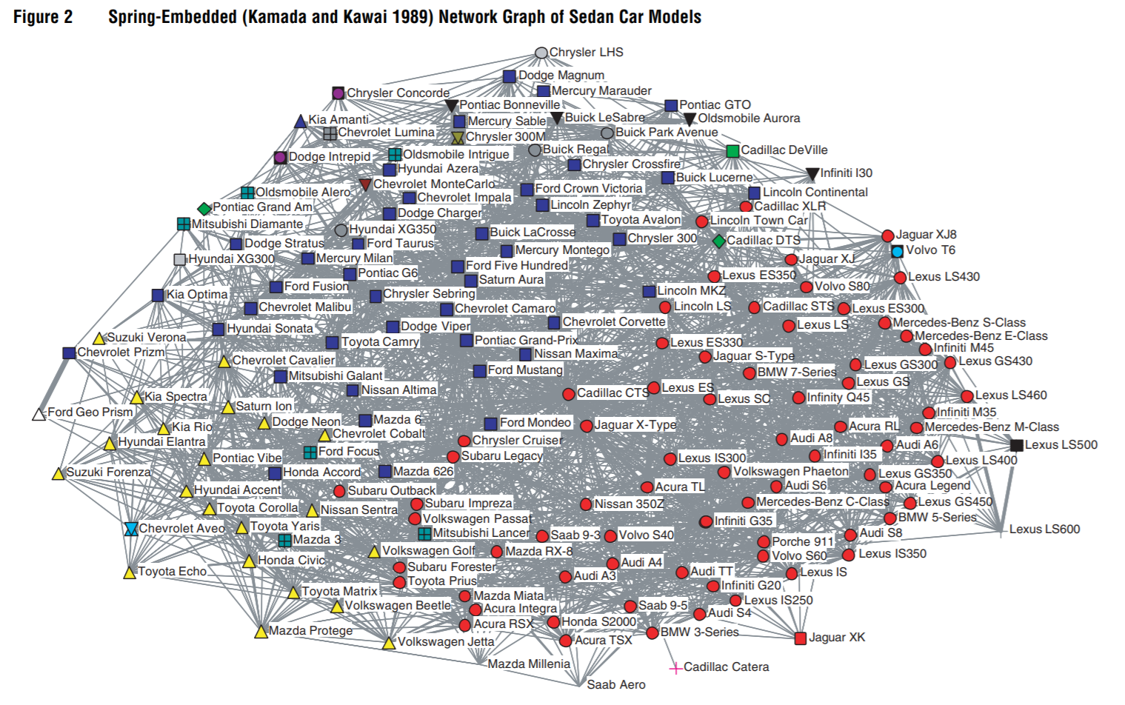
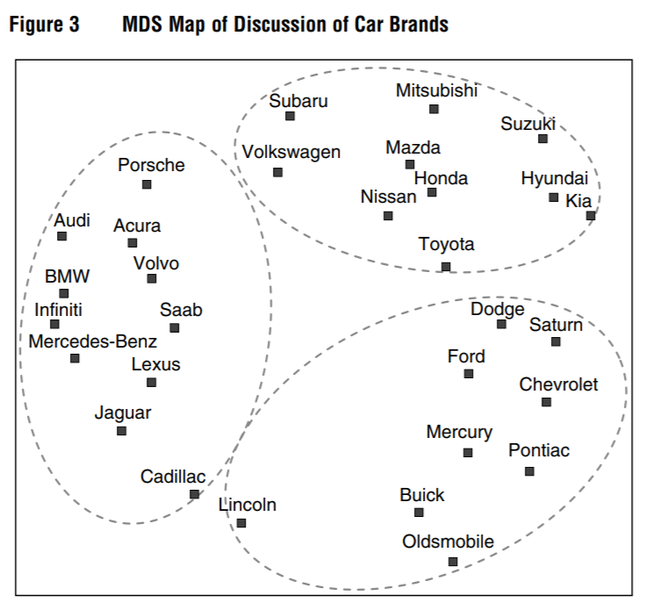
Community Detection (3/4)
What are the benefits of community detection?
To discover different stances regarding a certain topic.
Then, you may be able to identify opinion leaders of each party.
To know you competitors.
See who are frequently mentioned together in a forum.
Netzer et al.: Mine Your Own Business: Market-Structure Surveillance Through Text Mining, Marketing Science 31(3), pp. 521–543, 2012.

Slide 24
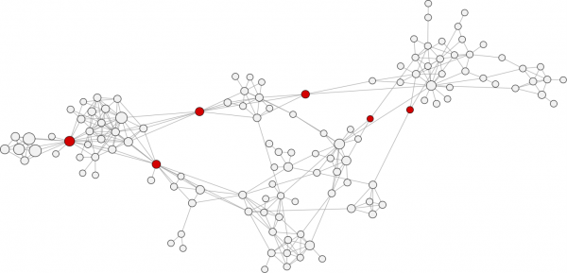
Community Detection (4/4)
How would you partition a network?
These nodes seem likes a good choice for partitioning a network into communities

Slide 25
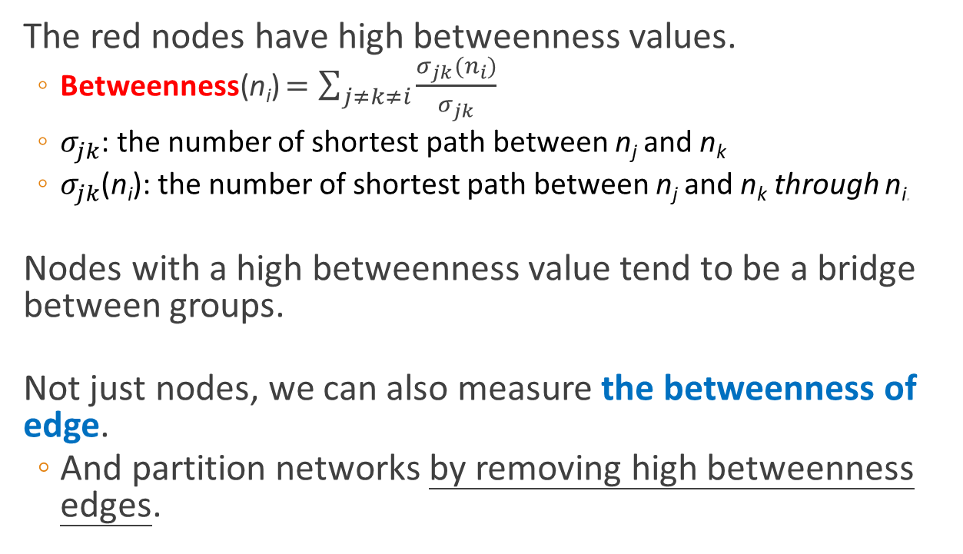
Betweenness
The red nodes have high betweenness values.
Betweenness(n_{i}) $=\sum_{j≠k≠i}{\frac{σ_{jk}(n_{i})}{σ_{jk}}}$
$σ_{jk}$: the number of shortest path between n_{j} and n_{k}
$σ_{jk}$(n_{i}): the number of shortest path between n_{j} and n_{k} through n_{i.}
Nodes with a high betweenness value tend to be a bridge between groups.
Not just nodes, we can also measure the betweenness of edge.
And partition networks by removing high betweenness edges.

Slide 26

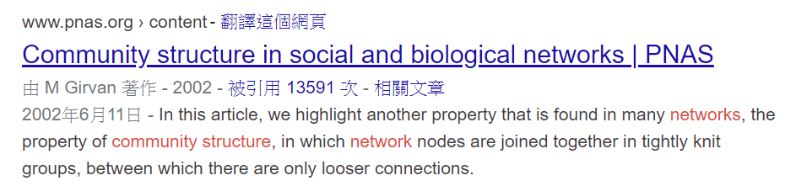
Girvan–Newman Algorithm
Calculate the betweenness of each edge
Remove the edge with the highest betweenness
Repeat if the result is not good enough
How do we know the quality??
Prof. Mark Newman

Slide 27
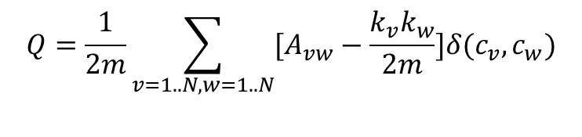
Modularity
Modularity: a measure of the quality of a network partition.
m: # of links in the network
A: the adjacency matrix
k_{v}: the degree of node v
c_{v}: the community of node v
δ(c_{v},c_{w}): 1 if c_{v} = c_{w}; 0 otherwise
The larger the value, the better will be the quality of the network partition.
$$Q=\frac{1}{2m}\sum_{v=1..N,w=1..N}{[A_{vw}−\frac{k_{v}k_{w}}{2m}]δ(c_{v},c_{w})}$$

Slide 28
Louvain Algorithm
A well-known two-step community detection method:
In the beginning, each node is assigned to its own community.
1. Each node i is placed into the neighbor community that resulted in the greatest modularity increase.
If no increase is possible, node i remains in its original community.
2. Builds a new network by grouping all of the nodes in the same community. Then, the first phase is re-applied to the new network.
New nodes are the communities from the previous phase.
Links from multiple nodes in the same community to a node in a different community are represented by weighted edges between communities.
Repeat the two steps until a local maximum of modularity is reached.

Slide 29
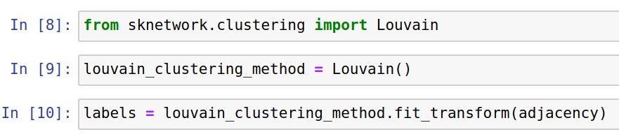
Let’s Practice (1/2)
sknetwork.clustering.Louvain:
a community detection algorithm that aims at maximizing modularity.
No need to specify the number of communities

Slide 30
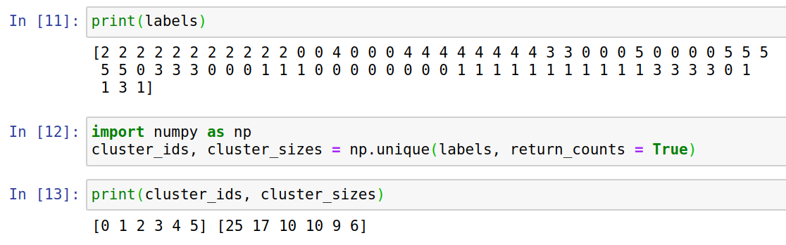
Let’s Practice (2/2)

Slide 31
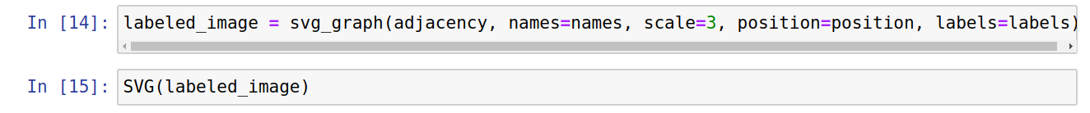
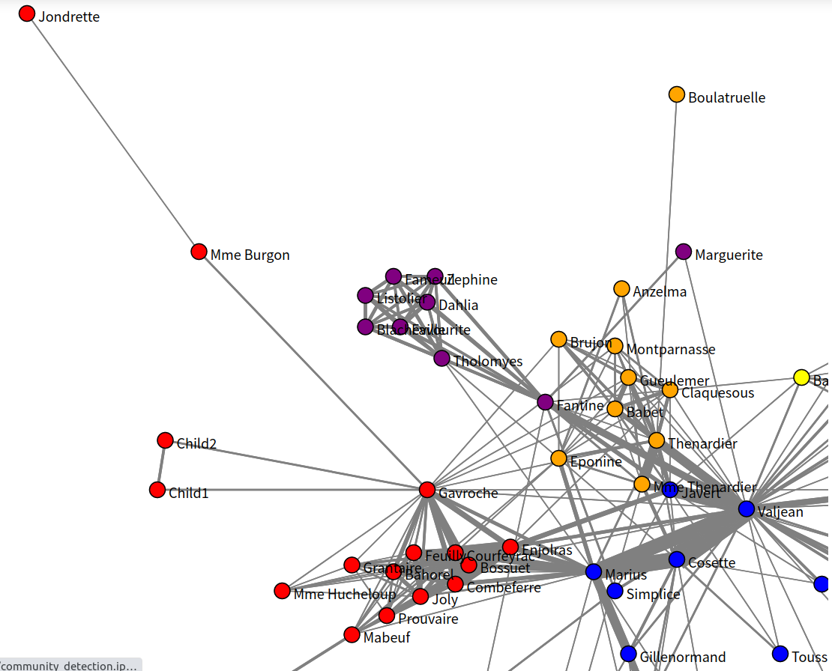
Let’s Practice

